Slide 1

Developing XML Web Services and Server Components with Visual C# .NET
PART IV
COMPONENT SERVICES
Amir Ahani
Microsoft Certified Solution Developer (MCSD .NET)
Microsoft Certified Application Developer (MCAD)
Microsoft Embedded Partner (www.mswep.com)

Slide 2

Enterprise Services
Object Pooling
Just-in-Time Activation
Object Construction
Automatic Transaction Management
Queued Components

Slide 3

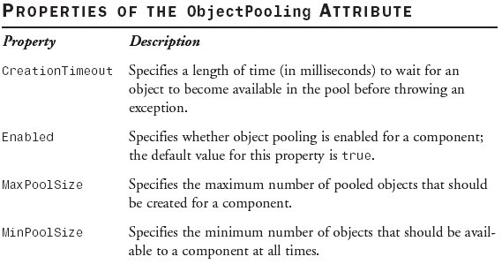
Object Pooling
In addition to using the ObjectPooling attribute, a object-pooled class also overrides the CanBePooled() method of the ServicedComponent class. The overridden version of this method should return either true or false. An object is pooled only if the CanBePooled() method returns true.
The object pooling service enables you to increase an application’s
scalability and performance by minimizing the time and resources
required in creating objects repeatedly.
You can configure a class to use the object pooling service by applying
the ObjectPooling attribute on the class.

Slide 4
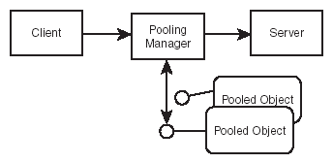
Object Pooling Architecture
All client requests to the server for an object are intercepted and
instead processed by the pooling manager.
If no object is available and no new object can be created because of
the size restriction of the pool, then the client requests are queued to
receive the first available object from the pool. If an object cannot be
made available within the time specified in the CreationTimeOut
property, an exception is thrown.

Slide 5
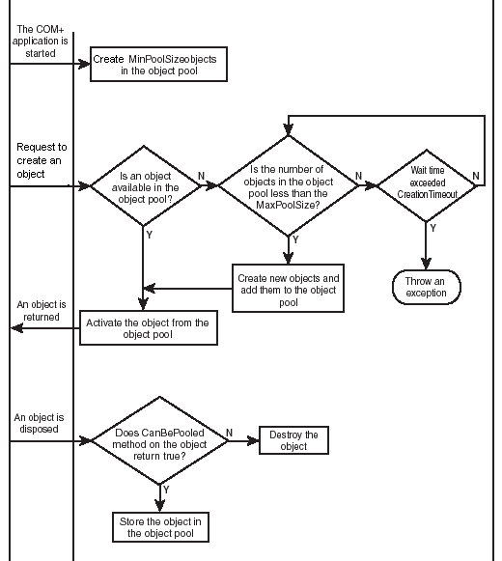
Pooling Manager
SBS 7.8, 7.9, 7.10 Examples

Slide 6
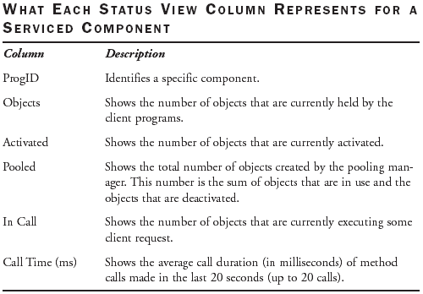
Monitoring Statistics of a Serviced Component
To aggregate information about all objects that are currently instantiated
and monitor how a component as a whole is working, Select the
‘Component Supports Events and Statistics’ option from Component
Services Administrative tool→ Activation tab.
If you want your
Components to
always install in
the COM+
Catalog with
Statistics option
turned on, you
should apply the
EventTrackingEnabled
attribute to your class.
SBS 7.11 Example

Slide 7
Just-in-Time Activation
Set the JustInTimeActivation attribute to true.
Any JIT-activated object will be created in its own context. The context
maintains a “done bit” to specify when the object will be deactivated. The
interception mechanism checks the done bit after each method call
finishes. If the value of the done bit is true, the object is deactivated;
otherwise the object continues to exist. The default value of the done bit
is false. Nevertheless, you can programmatically set the value of the
done bit by using any of the following techniques:
The ContextUtil.SetComplete() or ContextUtil.SetAbort() Methods
They also set the done bit to true.
The ContextUtil.DeactivateOnReturn Property—When you set this
property to true in a method, the property sets the done bit to true.
The AutoComplete Attribute—When you always want to deactivate
an object when the method call returns. This attribute automatically
calls ContextUtil.SetComplete() if the method completes successfully. If
the method throws an exception, the ContextUtil.SetAbort() method is
invoked. In both cases the done bit is automatically set to true.

Slide 8
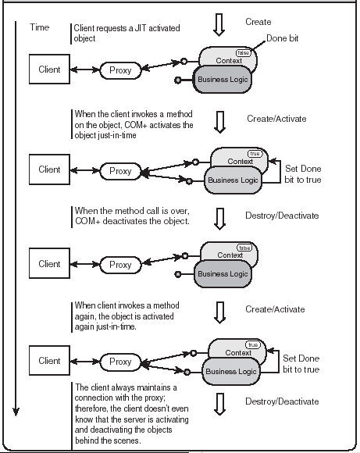
Just-in-Time
Activation

Slide 9
Using Just-in-Time Activation with Object
Pooling—A Recipe for High Throughput
Throughput is a measure of the processing done by an application during
a given time. Often, as the number of users increases, so does the
competition for a server’s resources. This normally results in an overall
decrease in throughput.
The JIT activation and object pooling services complement each other’s
features. When these services are used in combination, they can
maximize the throughput for an application by providing the following
benefits:
  JIT activation enables clients to hold long-lived references on the server
  object (through a proxy) without consuming server resources.
  JIT activation enables the server objects to be destroyed as soon as their
  work is over to minimize the resource consumption on the server.
  Object pooling caches the already created objects and saves time by
  activating and deactivating the objects from the pool rather than re-creating
  them from scratch.

Slide 10
Design Considerations for Using Just-in-Time
Activation and Object Pooling
An object’s lifetime is controlled by the server instead of the client.
Therefore, you need not call the Dispose() method on the server object
from the client. Actually, if you do so, the object will be re-created on the
server, just to be disposed of.
The server does not automatically deactivate an object. You need to set
the done bit to true for COM+ to destroy an object after the current
method call has completed. You can use any of the techniques
mentioned in the previous section to set the done bit to true.
The objects are created and destroyed after each method call.
Therefore, you should consider the server object as stateless.
JIT activation is not suitable for the objects that need to maintain
state across method calls.
SBS 7.12, 7.13 Examples

Slide 11
Object Construction
The object construction service of COM+ allows you to specify initialization
information for a serviced component. The advantage of using the construction
service is that it enables you to configure the string externally, using tools such
as the Component Services administrative tool.
Apply the ConstructionEnabled Attribute—You need to apply the
ConstructionEnabled attribute on a class that uses the object construction
service. This attribute has two properties: Enabled and Default. The default
values of these properties are true and empty string, respectively. The Default
property specifies the constructor string.
Override the Construct() Method—To receive the currently configured
constructor string from the COM+ Catalog, an object must override the
Construct() method of the ServicedComponent class. When the
ConstructionEnabled attribute is true, enterprise services calls this method
automatically after the constructor of the component has been executed. The
Construct() method receives the currently configured construction string as its
only parameter.
GPE 7.2 Example

Slide 12
Automatic Transaction Processing (MTS)
A transaction is a series of operations performed as a single unit. A transaction is
successful only when all the operations in that transaction succeed.
The COM+ transaction processing mechanism provides two significant
advantages over traditional transaction processing techniques:
1) Distributed Transactions—A local transaction is one whose scope is limited to
a single transactional resource, such as a SQL Server database. On the other
hand, a distributed transaction can span over several transaction-aware
resources. (MSDTC).
2) Automatic Transactions—A typical database transaction, such as the one
implemented with Transact SQL code or ADO.NET code, is manual in nature.
With manual transactions, you explicitly begin and end the transaction and
implement all the necessary logic to take care of the commit and rollback
process. However, COM+ allows automatic transaction services that you can use
in your program without writing any additional code. COM+ implements this with
the help of a Windows service called Microsoft Distributed Transaction
Coordinator (MSDTC).
SBS 7.14 Example

Slide 13
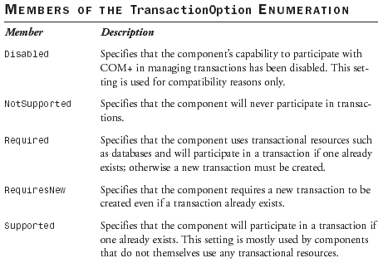
Elements of Transaction Processing
The Transaction Attribute
Applying the Transaction attribute to a class is equivalent to enabling
transactions through the Component Services administrative tool. The benefit of
applying an attribute in the program is that the component can execute in a pre-
configured state straight out of the box. The Transaction attribute takes a value
from the TransactionOption enumeration to specify how a component
participates in a transaction.

Slide 14
Context and Transaction
Each component that participates in a transaction has its own context.
The context stores various flags that specify an object’s state.
Two such flags are the done bit and the consistent bit. In addition to objects, the
transaction itself also has a context. The context of a transaction maintains an
abort bit. The purpose of the abort bit is to determine whether the transaction as
a whole failed or succeeded.

Slide 15
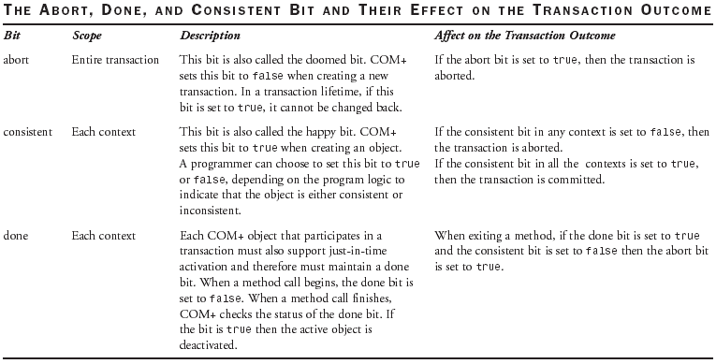
Context and Transaction

Slide 16
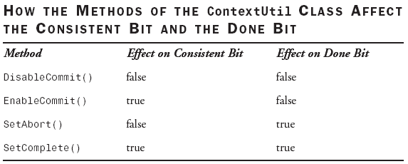
Context and Transaction

Slide 17
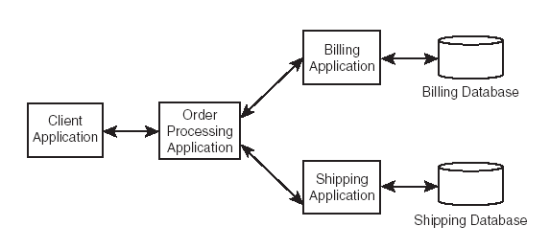
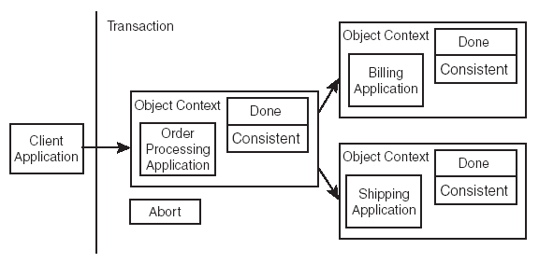
Automatic Transaction Architecture in a Distributed Scenario

Slide 18
Automatic Transaction Architecture Part1
1. When the client instantiates the Ordering component, an object context is
created. The done bit is set to false, whereas the consistent bit is set to true.
COM+ intercepts object invocation to check whether transaction services are
needed. The Ordering component has a Transaction attribute set to the
TransactionOption.RequiresNew value. COM+ creates a new transaction and
sets the abort bit to false. The Ordering component is designated as the root
object of the transaction. A root object coordinates with all other objects in a
transaction. The client fires a method on the Ordering component.
2. When the Ordering component instantiates the Billing component, COM+
intercepts to check whether transaction services are needed. The Billing
component has a Transaction attribute set to the TransactionOption.Supported
value. COM+ determines that the Billing component can support the transaction
started by the Ordering component and extends the scope of the transaction to
cover the Billing component. The context of the Billing object is initialized with
the consistent bit set to true and the done bit set to false.

Slide 19
Automatic Transaction Architecture Part2
3. The Ordering component calls a method on the Billing component.
The Billing object interacts with a SQL Server database to update a table of
confirmed shipments. COM+ takes the help of MSDTC to record any new and old
changes done to the database so that the changes can be rolled back at a later
stage. If the update is successful, the consistent bit is set to true, but if there
were any errors then the consistent bit is set to false. If the Billing object wishes
to deactivate itself after the method call, it sets the done bit to true; otherwise the
done bit remains set to false. If the done bit is true and the consistent bit is false
then the abort bit of the transaction is set to true and the control transfers to
Step 6.
4. When the method returns from the Billing object, COM+ intercepts the call and
records the status of the consistent bit. If the done bit is true, the Billing object is
deactivated.
5. The control comes back to the Ordering object and the Ordering component
now repeats steps 2 to 4 to instantiate the Shipping component and invoke a
method on the resulting object.

Slide 20
Automatic Transaction Architecture Part3
6. The control comes to the Ordering object. COM+ checks the status of the
abort bit. If the abort bit is true then the entire transaction is aborted and COM+
requests DTC to roll back any changes that were made to the database. If the
abort bit is false then the status of all the consistent bits is checked. If
any of these bits is false then the transaction is aborted and a rollback is
performed. If all the consistent bits are true, then COM+ requests DTC to finally
commit all the changes to the database.
7. Finally, the root object sets its done bit to true and returns from the method
that was invoked by the client. COM+ intercepts to deactivate the root object and
destroys the transaction. The control is transferred to the client.
SBS 7.15, 7.16, 7.17, 7.18 Examples

Slide 21
Practical Point
→ Availability
For many applications, availability is the number one priority. Availability becomes a major challenge when applications are distributed because the points of failure are now increased and some of them are not even in your control.
→ ACID Properties
A well-designed transaction has ACID properties. ACID is an acronym that stands for the following:
  Atomicity—Ensures that the entire transaction is either committed
  or rolled back.
  Consistency—Ensures that the system is always left at the correct
  state in case of the failure or success of a transaction.
  Isolation—Ensures data integrity by protecting concurrent transactions
  from seeing or being adversely affected by each other’s
  partial and uncommitted results.
  Durability—Ensures that the system can return to its original state
  in case of a failure.

Slide 22
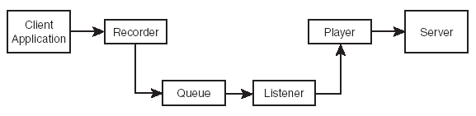
Queued Components (MSMQ) Part1
From the perspective of a client, a queued component is a serviced component
that can be invoked and executed asynchronously. The queued components are
based on the Microsoft Message Queuing (MSMQ) technology, which is a part of
the Windows operating system.
Communication between a client and a queued component involves four basic
components between the client and server.

Slide 23
Queued Components (MSMQ) Part2
Recorder—The Recorder kicks in when a client makes a call to the queued
component. The recorder records the call, packages it as a message, and
stores the message in the message queue.
Queue—The Queue is a repository of messages. Each COM+ application has a
set of queues assigned to it. There is one primary queue, five retry queues, and
one dead-letter queue. When the message arrives from the recorder, the
message waits in the primary queue to be picked up by the queued component.
If there is an error in processing, the message is sent to the first retry queue. If
the message processing fails in the first retry, the message is moved to the
second retry queue, and so on. The retry queues differ from each other in the
frequency with which they retry a message. The first retry queue retries
messages most frequently, whereas the fifth one is the slowest. If there is an
error in processing the message in the fifth queue, the message is finally moved
to a dead-letter queue where no further retries are made. Occasionally, you may
want to check the dead letter queue and custom process any failed messages.
Listener—The Listener’s role is to poll the queue for incoming messages and,
when there is one, pass the message to the player.
Player—The Player unpacks a message and calls the invoke methods that were
recorded by the client on the queued component.

Slide 24
Queued Components (MSMQ) Part3
First → Creating a Queued Component
Creating a queued component is just like creating any other serviced component.
To configure a component to work as a queued component you need to apply
the following two attributes:
ApplicationQueuing Attribute—You apply this attribute at the assembly level to
enable queuing support for an application. If a client will call the queued
component, then the QueueListenerEnabled property must be set to true.
[assembly: ApplicationQueuing(Enabled=true, QueueListenerEnabled=true)]
InterfaceQueueing Attribute—You apply this attribute at the component level to
specify the interface through which COM+ allows the calls on the component to
be recorded and stored in the queue. For example:
[InterfaceQueuing(Enabled=true,Interface=”IOrdering”)]
SBS 7.19 Example

Slide 25
Queued Components (MSMQ) Part4
SBS 7.20 Example
Second → Creating a Client for a Queued Component
You need a way in which you can record a message for the client and store that
in a queue so that the server object can read that message when possible.
Call the Marshal.BindToMoniker() method and pass it a moniker string that
corresponds to the interface of the queued component. The moniker string is
formed by preceding the full type name (qualified with namespace) with the string
“queue:/new:”. For example:
Marshal.BindToMoniker(@”queue:/new:StepByStep7_19.Ordering”);
The Marshal.BindToMoniker() method returns a reference to the interface
identified by the given moniker string.
Use the interface reference obtained in step 1 to execute methods on the
queued component. These methods are not executed immediately; instead, they are recorded and placed in the message queue.
When you’ve finished calling methods, call the Marshal.ReleaseComObject()
method to release the reference to the interface reference obtained in step 1.

